Slide 1


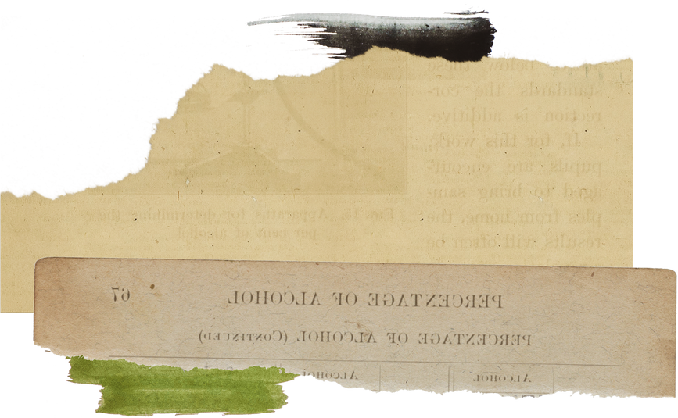


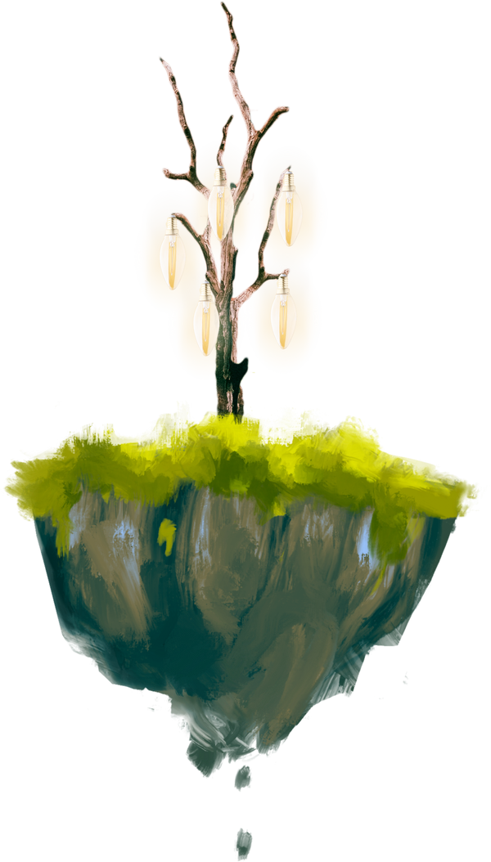
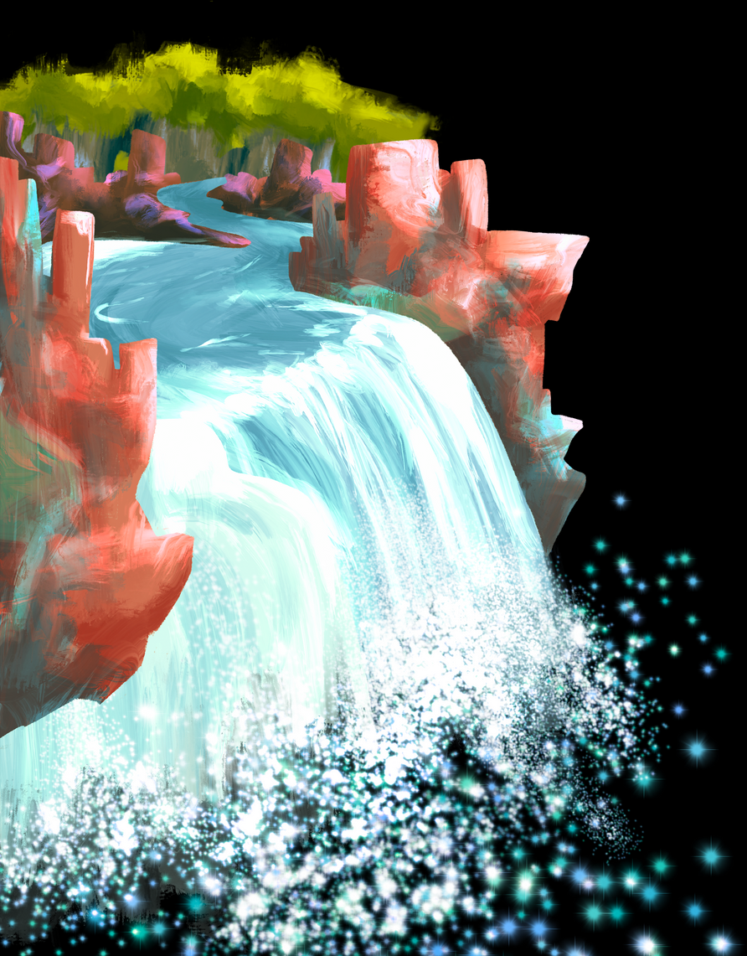
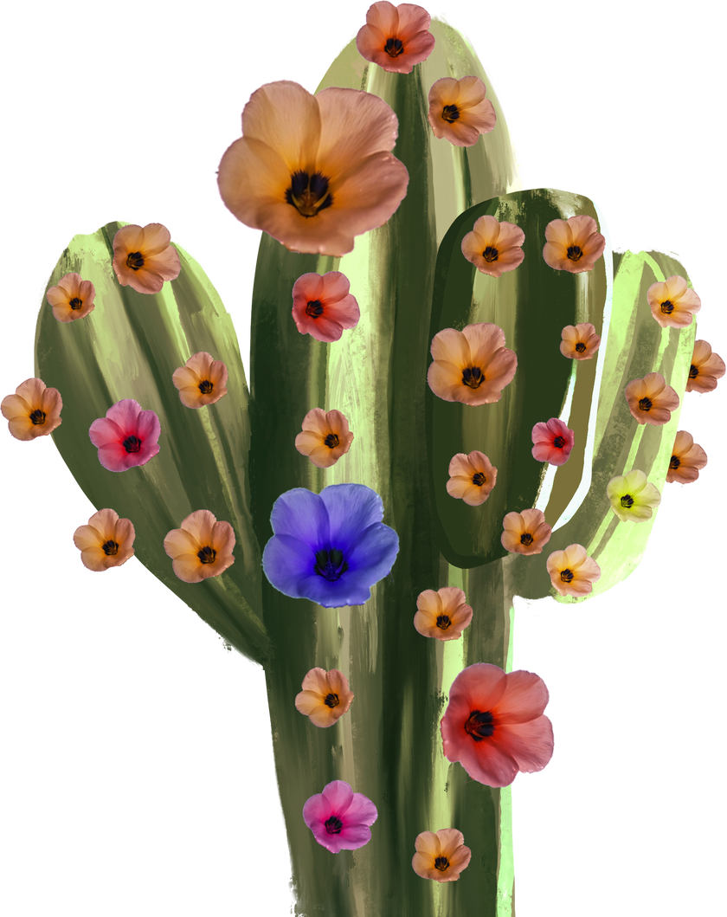
PLURAL
PLURAL
A Digital Gallery of Malaysian Cultural Arts

Slide 2
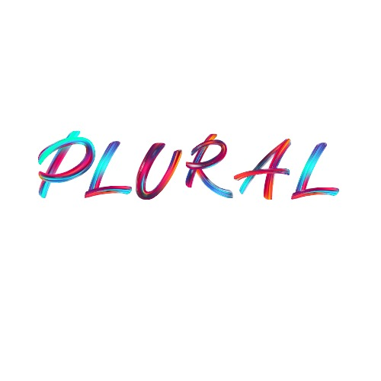
Purpose
Purpose
PLURAL is a website that showcases expressive and cultural artworks by local Malaysian artists. Its main objective is to preserve, promote, and make traditional and modern Malaysian visual art accessible through an interactive online gallery. The design reflects an appreciation for art through smooth user navigation and a minimalist layout.

Slide 3
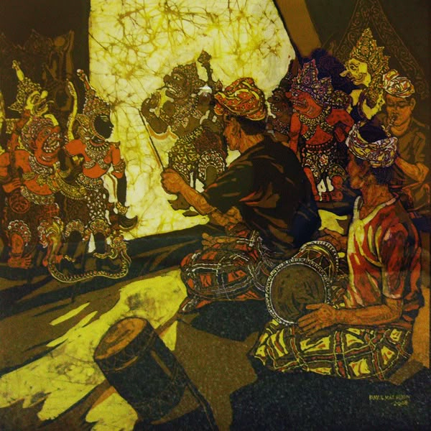

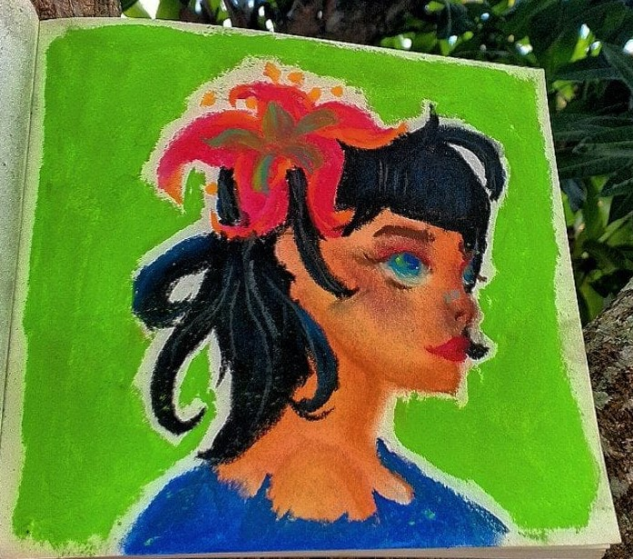
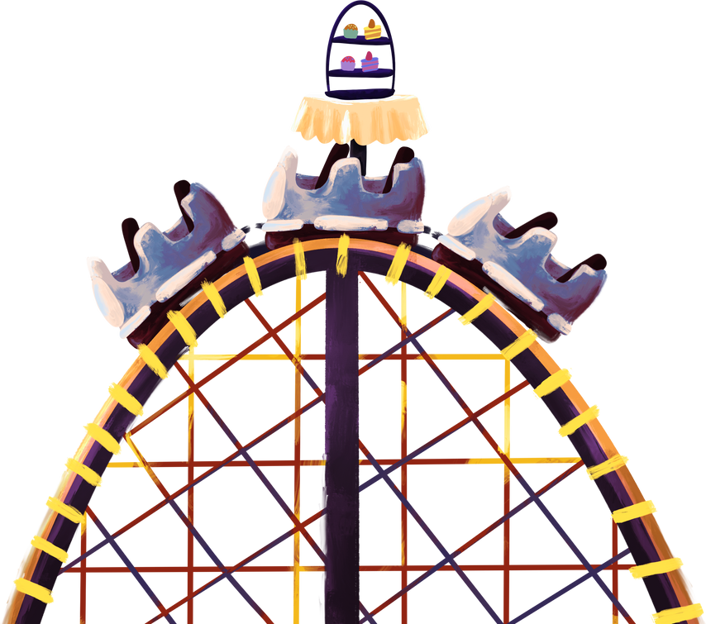
Behind The Story
Behind The Story
The inspiration came from the growing need to highlight Malaysian talent in the arts scene, especially those whose work reflects local identity and cultural values. PLURAL is my way of contributing to preserving heritage and giving artists an online platform to shine.
Why don’t we see more Malaysian art online, celebrated the way it deserves?
Why don’t we see more Malaysian art online, celebrated the way it deserves?
By creating this platform, I hope to amplify voices that often go unheard, give visibility to underrepresented artists, and invite users whether students, researchers, or casual browsers to rediscover what makes Malaysian art plural in every sense of the word.

Slide 4
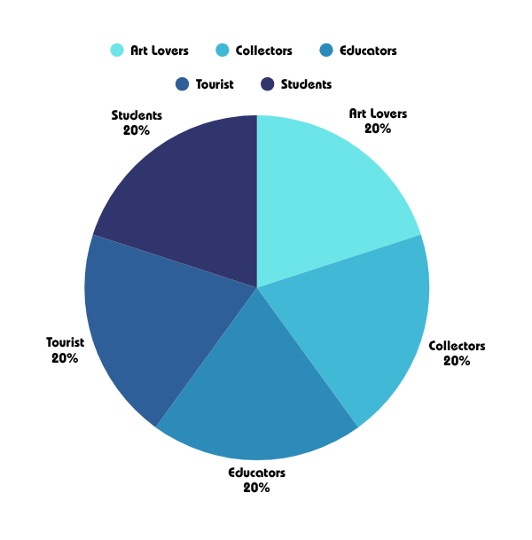
Target Audience
Target Audience
Art lovers and collectors
Students and educators in creative fields
Cultural researchers
General public interested in Malaysian heritage
It serves those looking to explore visual Malaysian culture in a digital form.

Slide 5
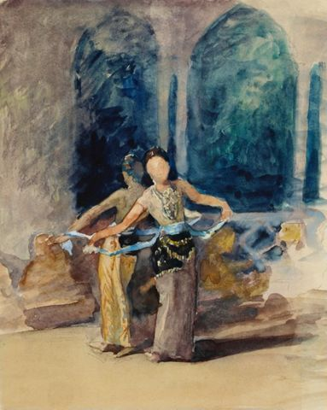
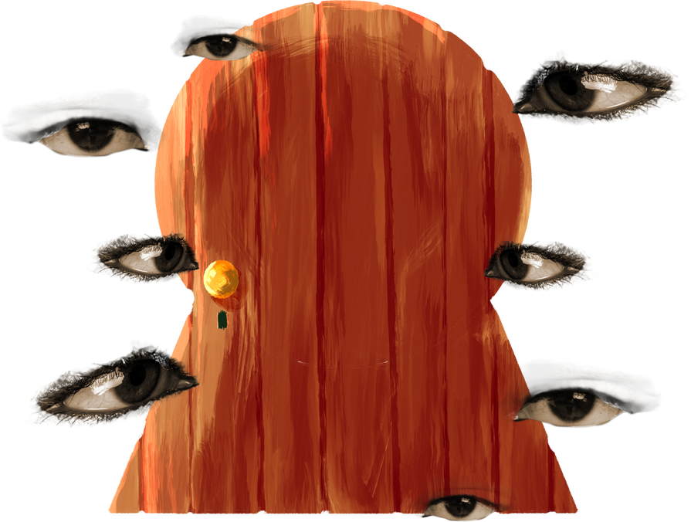
Development Tools and Technologies
Development Tools and Technologies
Languages
HTML, CSS, JavaScript
Libraries
GSAP for animation
Fonts
Google Fonts (Poppins, Josefin Sans)
Editor
Visual Studio Code
Hosting
Local preview / GitHub Pages (optional)

Slide 6

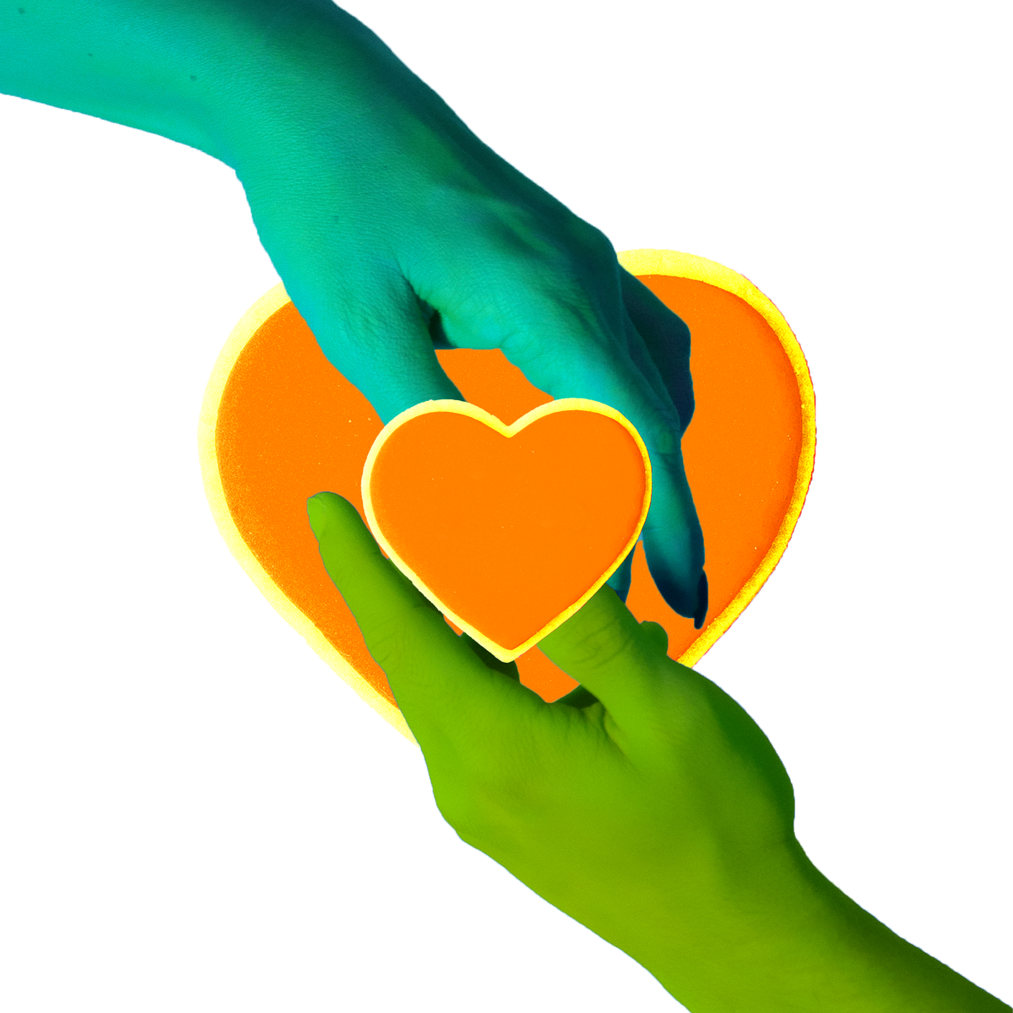
Key Features
Key Features
Animated navigation with GSAP
Responsive layout and mobile-friendly design
Artist showcase with images, names, and artwork titles
Interactive hover effects and animated menu transitions
Themed visual identity consistent with Malaysian culture
Modern typography and fixed interactive elements like cursors and logos

Slide 7
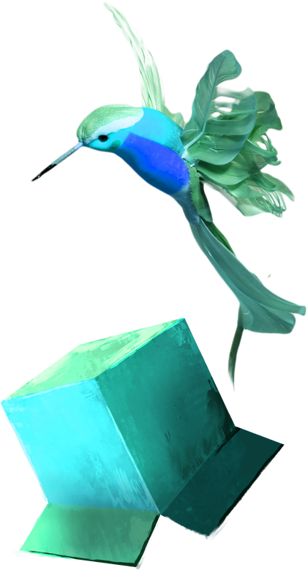

Enhancements
Enhancements
Future improvements may include:
Adding artist biography pages
Implementing filtering by art category (e.g., digital art, painting, crafts)
Search functionality for easier discovery
Embedding video interviews or behind-the-scenes content
Enabling user submissions or community engagement features

Slide 8
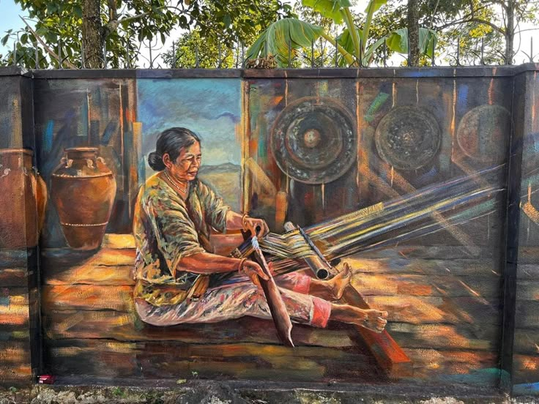
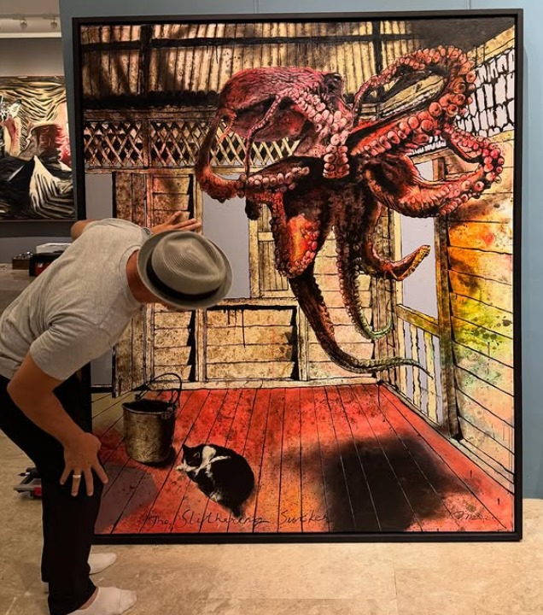
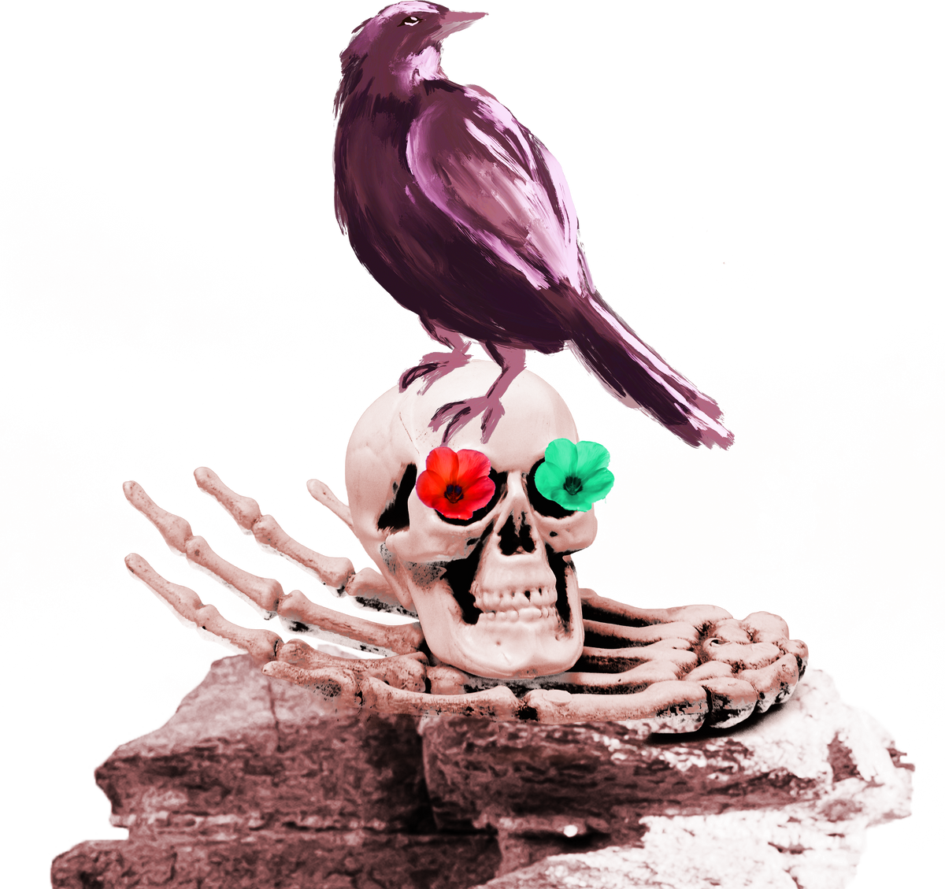

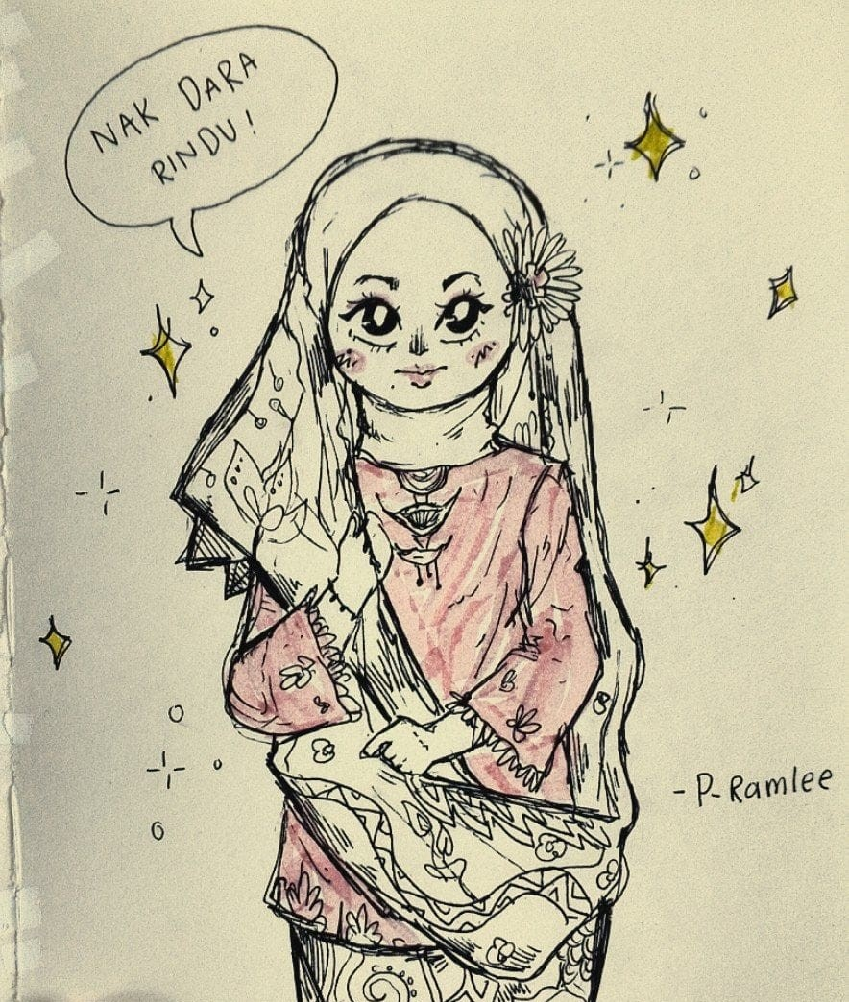
Artworks Overview
Artworks Overview

Slide 9





+6017-4495551
www.reallygreatsite.com
ainulaleeya08@gmail.com
@aalyaisboring
Thank You
Thank You

